Slide 1

Welcome to Purford Green
Information for new children and their families starting school.

Slide 2
Key staff
Miss Emma Bloomfield – Executive Headteacher
Mrs Rachel Thomson – Head of School
Mrs Karen Rouse – Deputy Headteacher
Miss Brittany Stoneman – Assistant Headteacher
Miss Michelle Machin – Class Teacher and EYFS Leader
Mr Luke Hammond- Class Teacher on Mondays
Mrs Morgan, Mrs Bianka, Mrs Hunter
Mrs Madge – Inclusion Assistant
Mrs Hammond – Learning Mentor

Slide 3
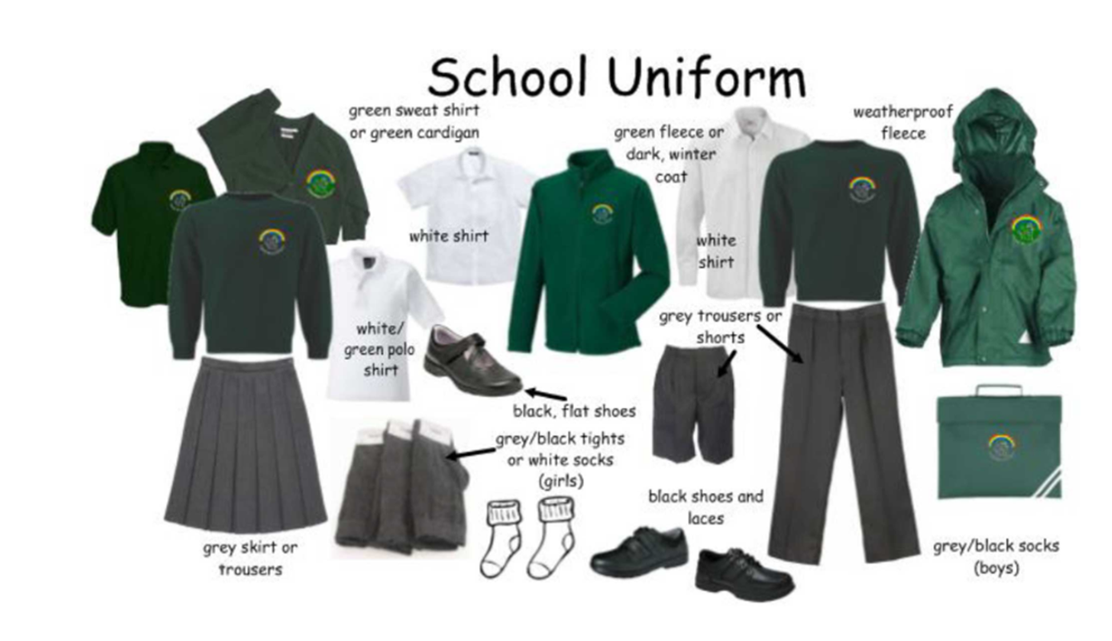
School uniform
School uniform creates a sense of belonging and togetherness within the school community, so all children are expected to wear full school uniform, including black shoes.
Uniform can be bought with school logo on from Create Identity.
Uniform does not need to have the school logo on and items can be purchased from Asda, Tesco’s and Sainsburys.
All uniform needs to be labelled so that after PE, children can find their own uniform and not go home with someone else’s. This includes shoes!
Indelible marker pen is the best to label clothes and school belongings.
Your child will also need a pair of wellies – labelled with their name that will be kept in school to use in the outside area.
Children in Reception have access to the outside area every day so please ensure appropriate clothing is worn. (coats, hats, sun hats, etc.)
Long hair must be tied back with any hair hands in school colours – green, white, black, grey

Slide 4
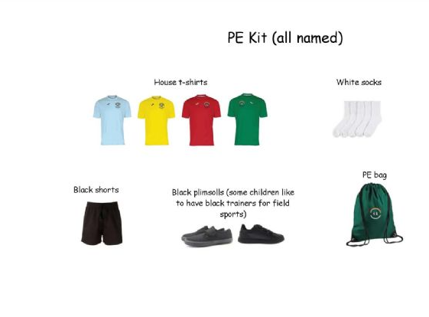
PE Kit
PE Kit – all items need to be labelled with your child’s name or initials, including shoes and the bag itself!

Slide 5
Start of the of the day
Children should arrive in school, ready to walk in at 8.40am so they are in class and ready to learn at 8.50am.
Activities start at 8.40am and teaching starts at 8.50am so your child will miss out if they arrive late.
Children often become worried and anxious when walking into class late as learning has already begun, so please help to avoid that.

Slide 6
Attendance
Good school attendance is key to ensuring children make good progress in school.
We aim that every children has above 97% attendance each year.
We get in touch with families if attendance begins to fall and if it continues parents are asked to meet with the Education Welfare Officer.
If your child is unwell, please call the office before 9.30am, we have an answer machine for you to leave a message.
If we haven’t heard from you, we will call you before 11.30am to check where your child is. If we can’t get hold of you, we will carry out a home visit.

Slide 7
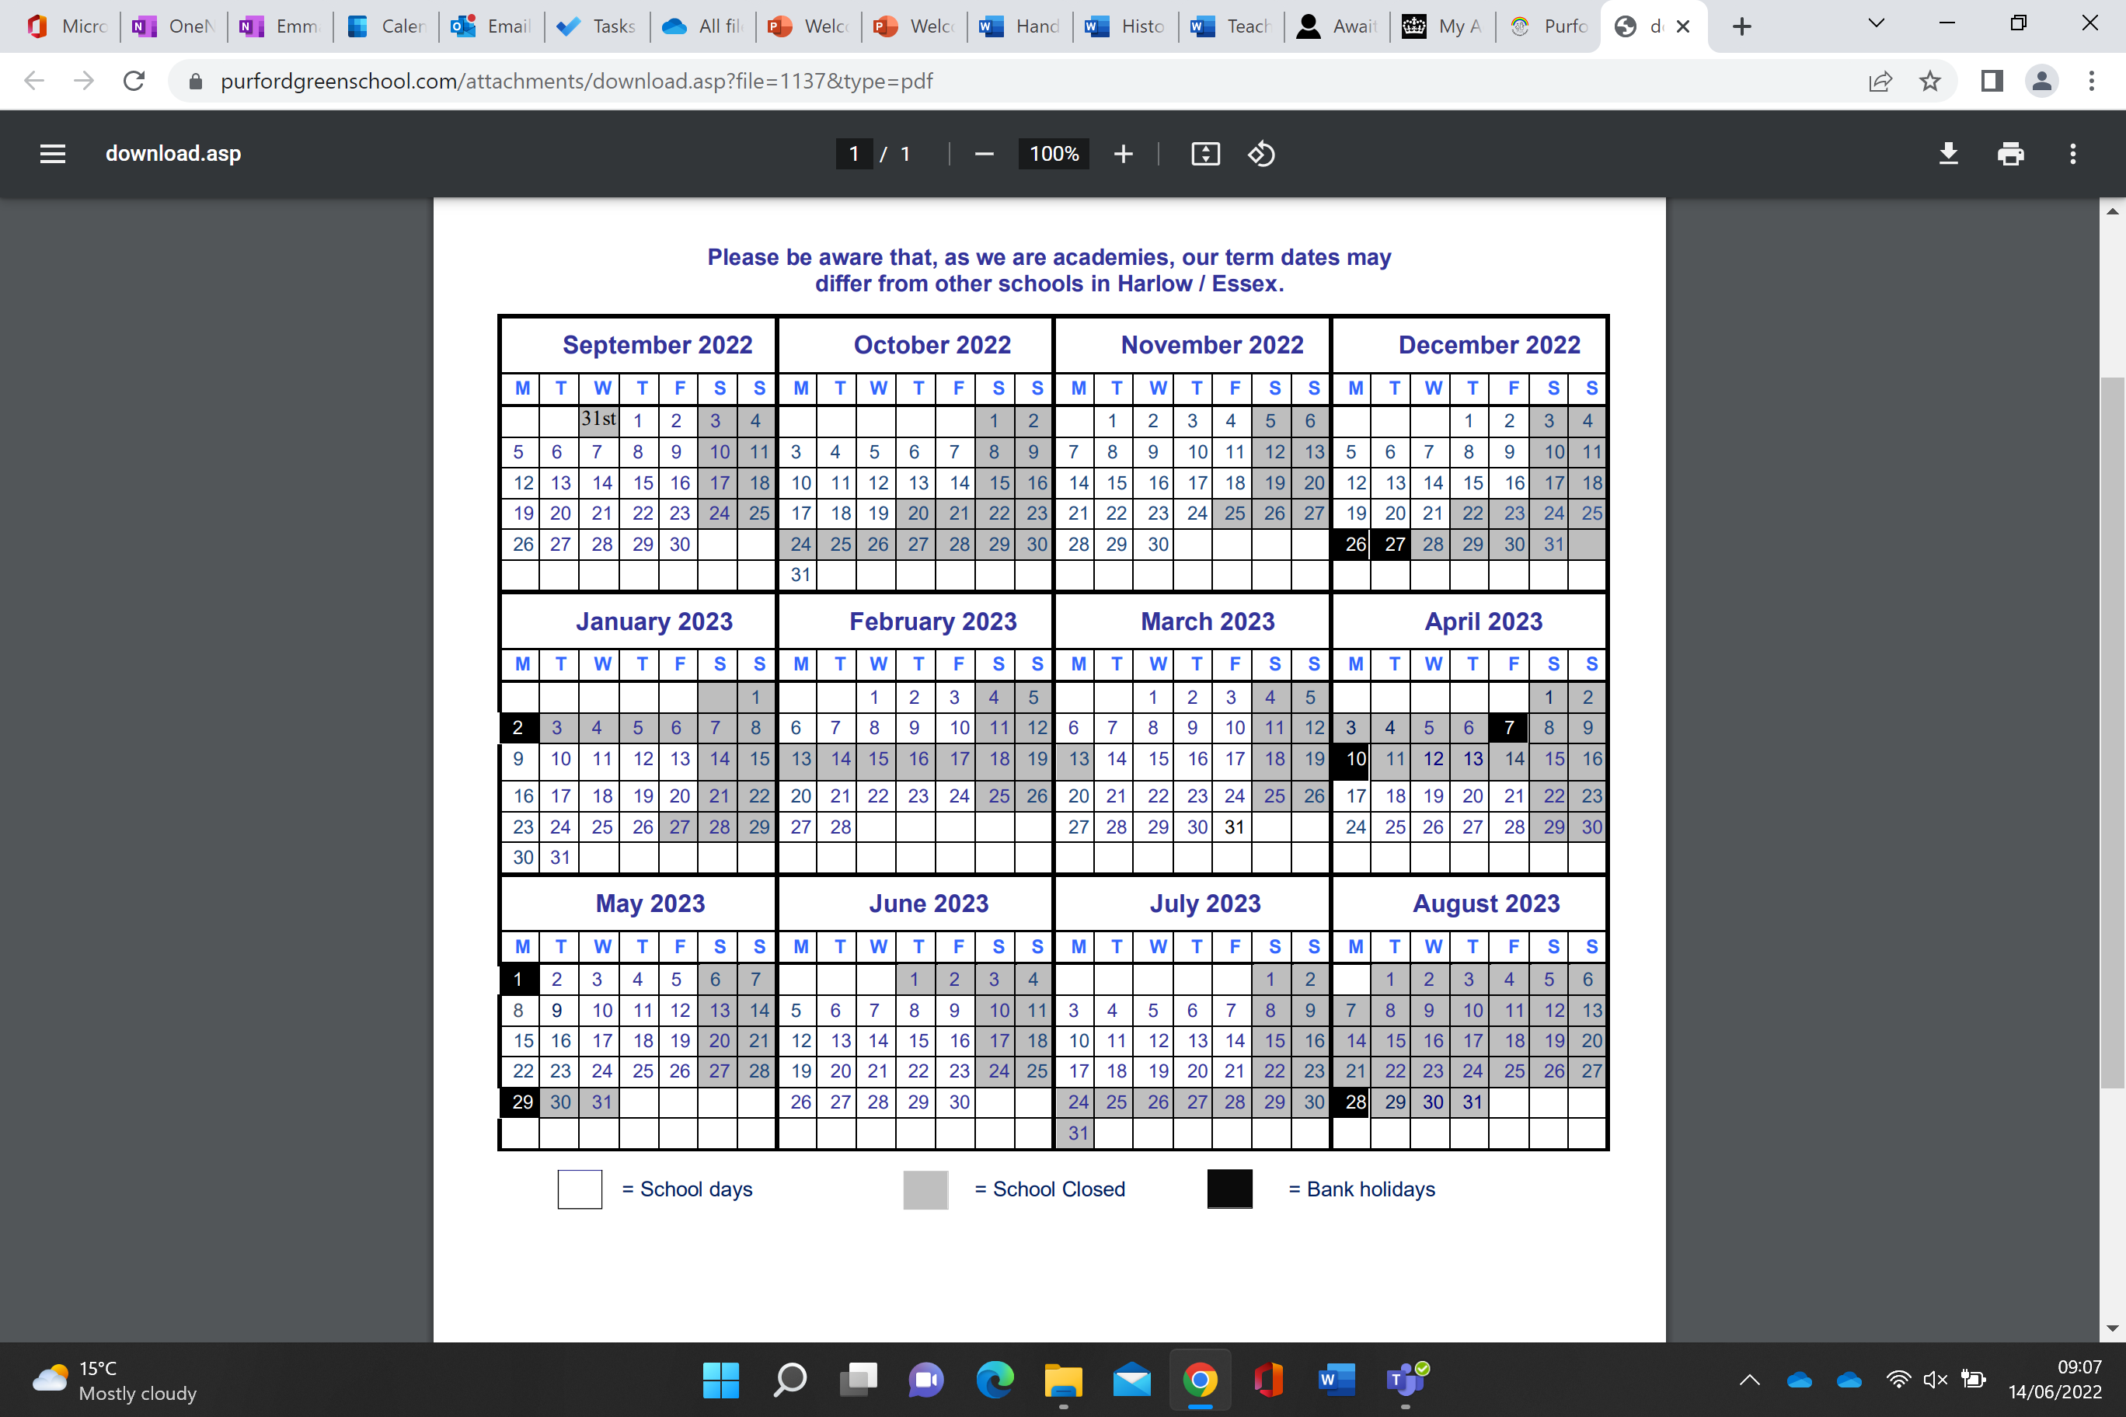
We publish our term dates and INSET days in advance. These are sent via email, class Dojo and are on our Website.
If you need time off in term time, please complete a request form which is available at the office.
Unfortunately, we are not permitted to agree to holidays during term time.
However, please be honest with us. Whilst we can’t agree to them, we do understand it is cheaper.
We do have to work with Essex County Council to issue fines so do factor that into the cost of your holiday.

Slide 8

Contact Details
Please make sure your contact details are up to date.
We must have three contact names to call in case of an emergency.
We will always try to call parents first.
You will need to create a password for collecting your child if someone different collects them – they will need to say the password.
We will not release your child to someone who is not able to give the password for safeguarding reasons.
Anyone collecting your child must be over 16 years old.

Slide 9
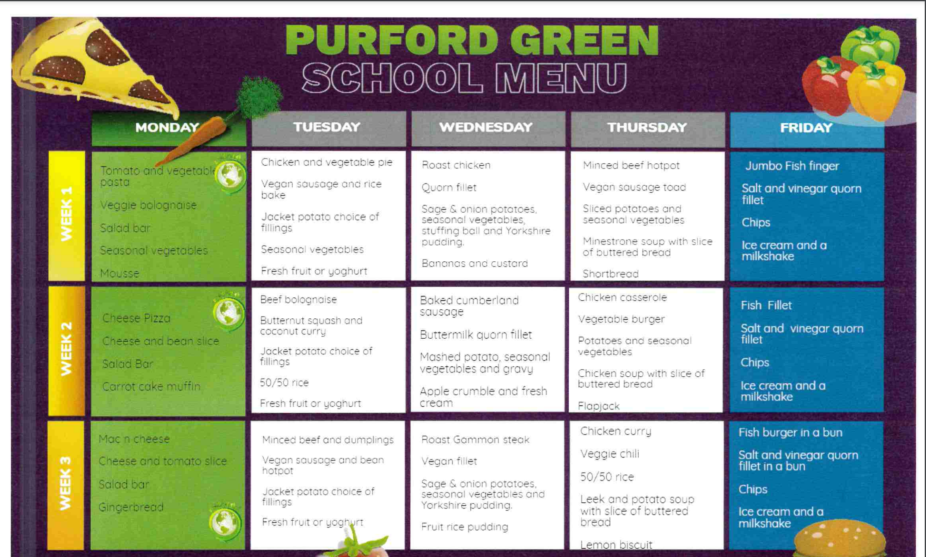
School Meals
All children in Year R, Year 1 and Year 2 are entitled to a universal free school meal.
All our meals are cooked from scratch everyday using meat supplied fresh from a local butcher.
There are three options most days, we can cater for those who eat halal meat and vegetarians as well as those who need a gluten free or dairy free diet.
There is unlimited access to fresh fruit and salad at lunchtime.
Fresh water is available all day every day.
Adults will monitor how your child is doing with school dinners. If your child is not eating them on a regular basis, it will be suggested you bring in a packed lunch for them.

Slide 10
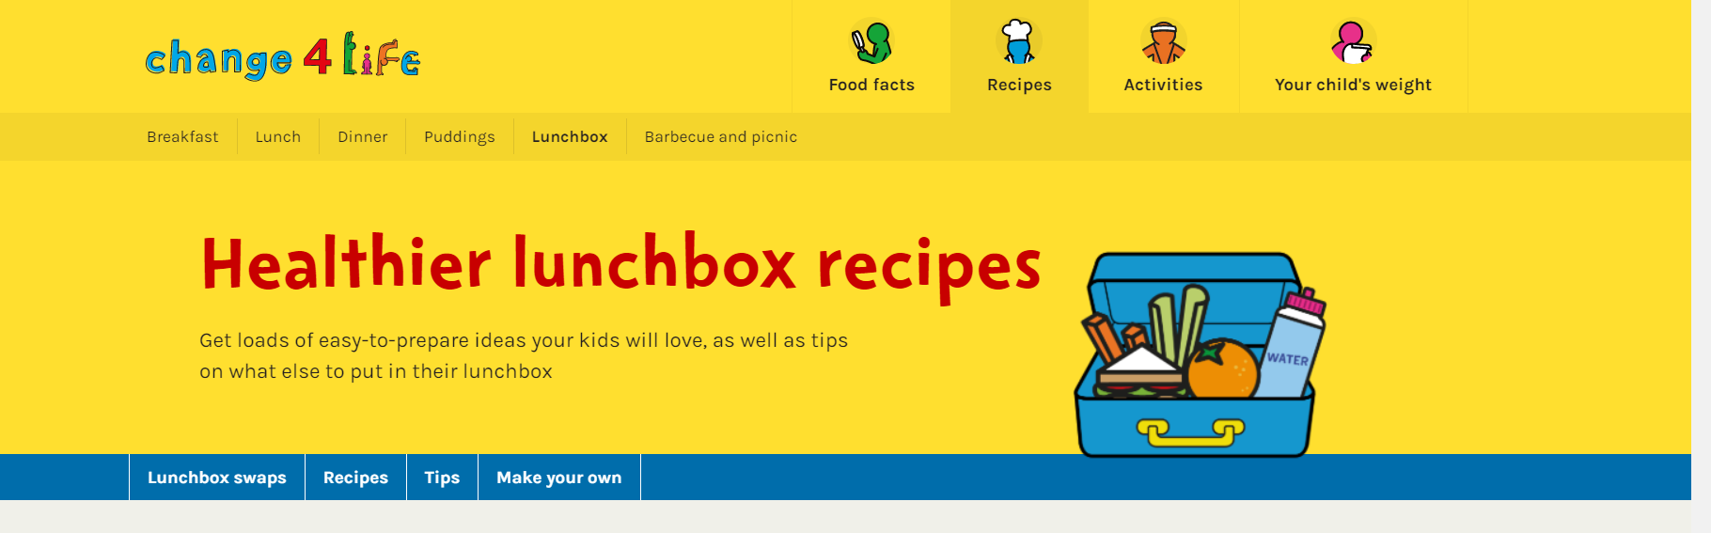
Packed Lunch
If you know your child is a fussy eater, we recommend providing your child with a packed lunch from home.
Packed lunches must be balanced and healthy.
A sandwich / cold pasta or crackers are recommended each day.
No fizzy drinks, nuts (including nut products) or sweets
We only have chocolate items on Fridays.
Visit the Change 4 life website for ideas.

Slide 11
Payment
System
We are a cashless school.
Payments for trips, breakfast club and other activities are paid for using Schoolcomms
You will be given log in details once your child starts with us.

Slide 12
Snacks
Every child is provided with free snack every day at school which is fresh fruit or raw vegetables.
Every child has free milk every day until they are 5 years old. After this time you can choose to pay for the milk. You will need to fill in a form online from the supplier. The office will tell you how this is done.

Slide 13
Inclusion Team
We will always help and support your child in every way we can throughout their time here with us.
Our inclusion team are always available if you have any concerns about your child.
Our Learning Mentor, Mrs Hammond, is always available to provide children and their families with social and emotional support.
Mrs Madge will support with any concerns you or the class teacher may have around learning needs.

Slide 14
Support for your child
If you have provided us with your national insurance details, we will run a check to see if your child is entitled to pupil premium funding. If they are, this means they can access additional support in school for the next 6 years.

Slide 15
Communication from you to us
Communication between school adults and families is key to every child being happy in school.
If you need to, please talk to someone. You can do this by:
Asking to see the teacher when you collect your child at the end of a session.
Calling the teacher outside of teaching hours using the school office number.
Send an email to school requesting an appointment with the class teacher.
Send a message via Class Dojo.
The class teacher should always be your first stop if you have a worry.

Slide 16




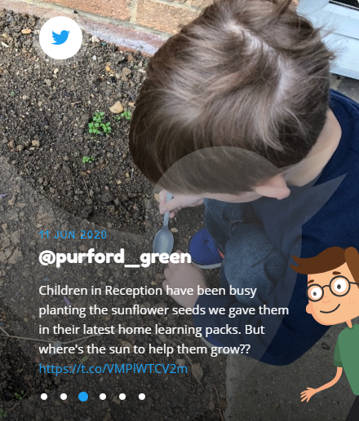
Our communication to you
Email
Website information
Newsletters via email
Class letters via email
Class Dojo
Twitter
Telephone call

Slide 17
Trips / Life Experiences / Life Skills
At Purford Green, we pride ourselves on giving children extra experiences and building life skills.
We usually have a couple of trips in Reception (one local and one further afield). Children in older year groups enjoy trips to the beach, castles, the theatre and even overnight stays in KS2).
We teach children life skills and give them experiences throughout their time with us that they may not experience otherwise.
Examples of life skills across the school | Examples of life experiences across the school
Use cutlery to eat Know how to make an emergency phone call Learn to make a cup of tea Learn to tie a tie Solve conflicts with peers | Jump in muddy puddles Paddle in the sea Feed an animal Go star gazing Sing songs around a campfire Perform at the O2

Slide 18
What does a typical day in EYFS look like?
The first few weeks are all about getting to know your children and developing good relationships. Once children are fully settled, a daily routine will begin which will typically look something like this:
8:40-8:50 Come in, complete early morning work and register
8:55-9:25 Phonics
9:20-11:20 Child-led learning/adult led activities
During this time, one adult typically works with small groups or individual children during this time, another adult engages with children supporting their learning in their play)
Snack is available for children to access freely during the morning
11:30-12:00 Maths
12:00-12:55 Lunch time (mix with KS1)
1:00-1:05 Register
1:10-1:30 Carpet time (topic/music/PSHE/etc)
1:35-2:35 Child-led learning/adult led activities (as above)
2:40-3:00 Story time
3:10 Home time
Please note that some days vary due to PPA, PE lessons, assemblies, trips, special school theme days, etc.

Slide 19
What does my child need to bring to school?
Every day
A named bookbag (this will be empty to start with) One will be provided for you.
A named water bottle
A coat
Extra clothing for the weather (e.g. sun hat, winter hat/scarf/gloves)
To stay in school
A named PE kit (this will be sent home at half terms for a wash and needs to be returned when your child returns to school)
A pair of named wellies (these will stay in school in year)
Not needed at all in Reception
pencil cases/pencils/pens/etc.
Parents must hand any medication to the school office (e.g. asthma pumps) on the day your child starts school. These will be kept in school.
Notes:
A book bag will be given to your child. Please do not buy one.

Slide 20

Home Learning
From an early age we expect children to carry on learning at home with parents / carers.
Evidence shows parental support is key to pupil progress.
In Reception home learning is reading or sharing a book at home for 10 minutes per day as well as learning tricky words.
Notes:
Reading to young children is an important way to help them build language skills. It exposes them to new words and ways of using language. It also helps them learn general information about the world, which makes it easier for them to learn about new subjects at school.
Books also help children build empathy and learn how to handle challenging feelings. Parents can use reading time as a chance to talk about emotions and how to cope with them. For example, you might say: “Have you ever felt as angry as the girl in this book? What would you do if you did?”
Even five minutes of reading together gives you and your child a chance to slow down and connect with each other. And the sensory experience of sitting with you and hearing your voice also engages their brain in a way that makes learning easier.
Children in Reception will read with an adult twice a week as a minimum. They will also take part in reading activities daily. Children should be reading their books at home daily with parents.

Slide 21

What skills should I get my child to work on over the summer which will help them?
Notes:
What does being "school ready" mean?
having strong social skills
can cope emotionally with being separated from their parents
are relatively independent in their own personal care
have a curiosity about the world and a desire to learn.

Slide 22

Everyone at Purford Green is looking forward to welcoming you all to our community.
Please sign up for a home visit if your child does not already attend our nursery.
Please chat to Mrs Madge if you feel your child would benefit from any extra support.
We are here to answer any questions you may have.
Notes:
Group A nursery Group B non nursery. Only group B for Stay and play / home visits

